Slide 1
Council Member
Robert John Smith
District 8, Garland TX
February 14, 2019

Slide 2
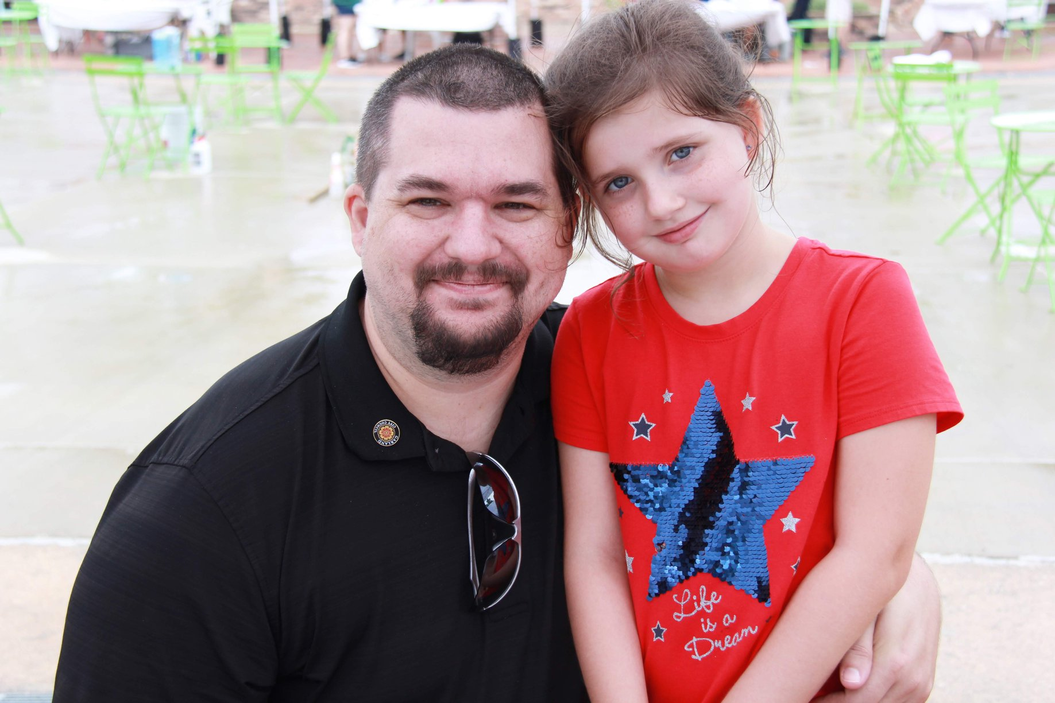
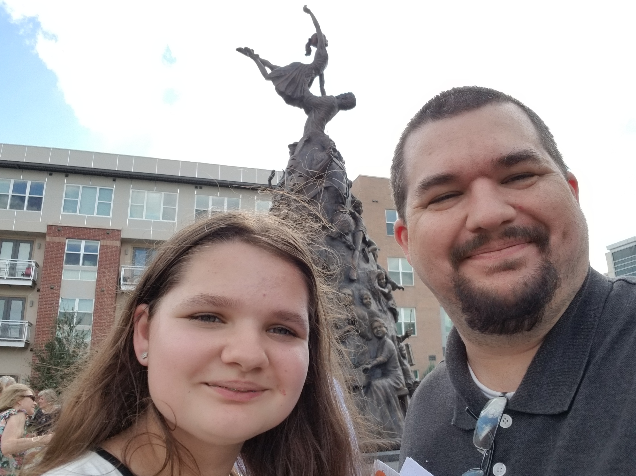
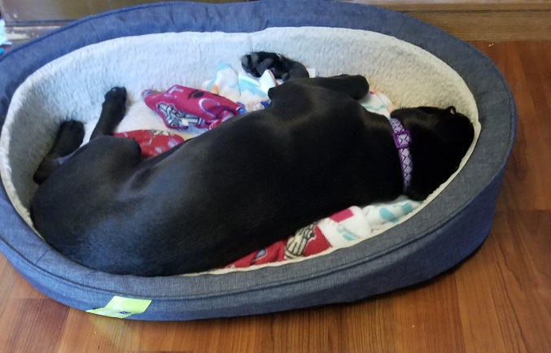
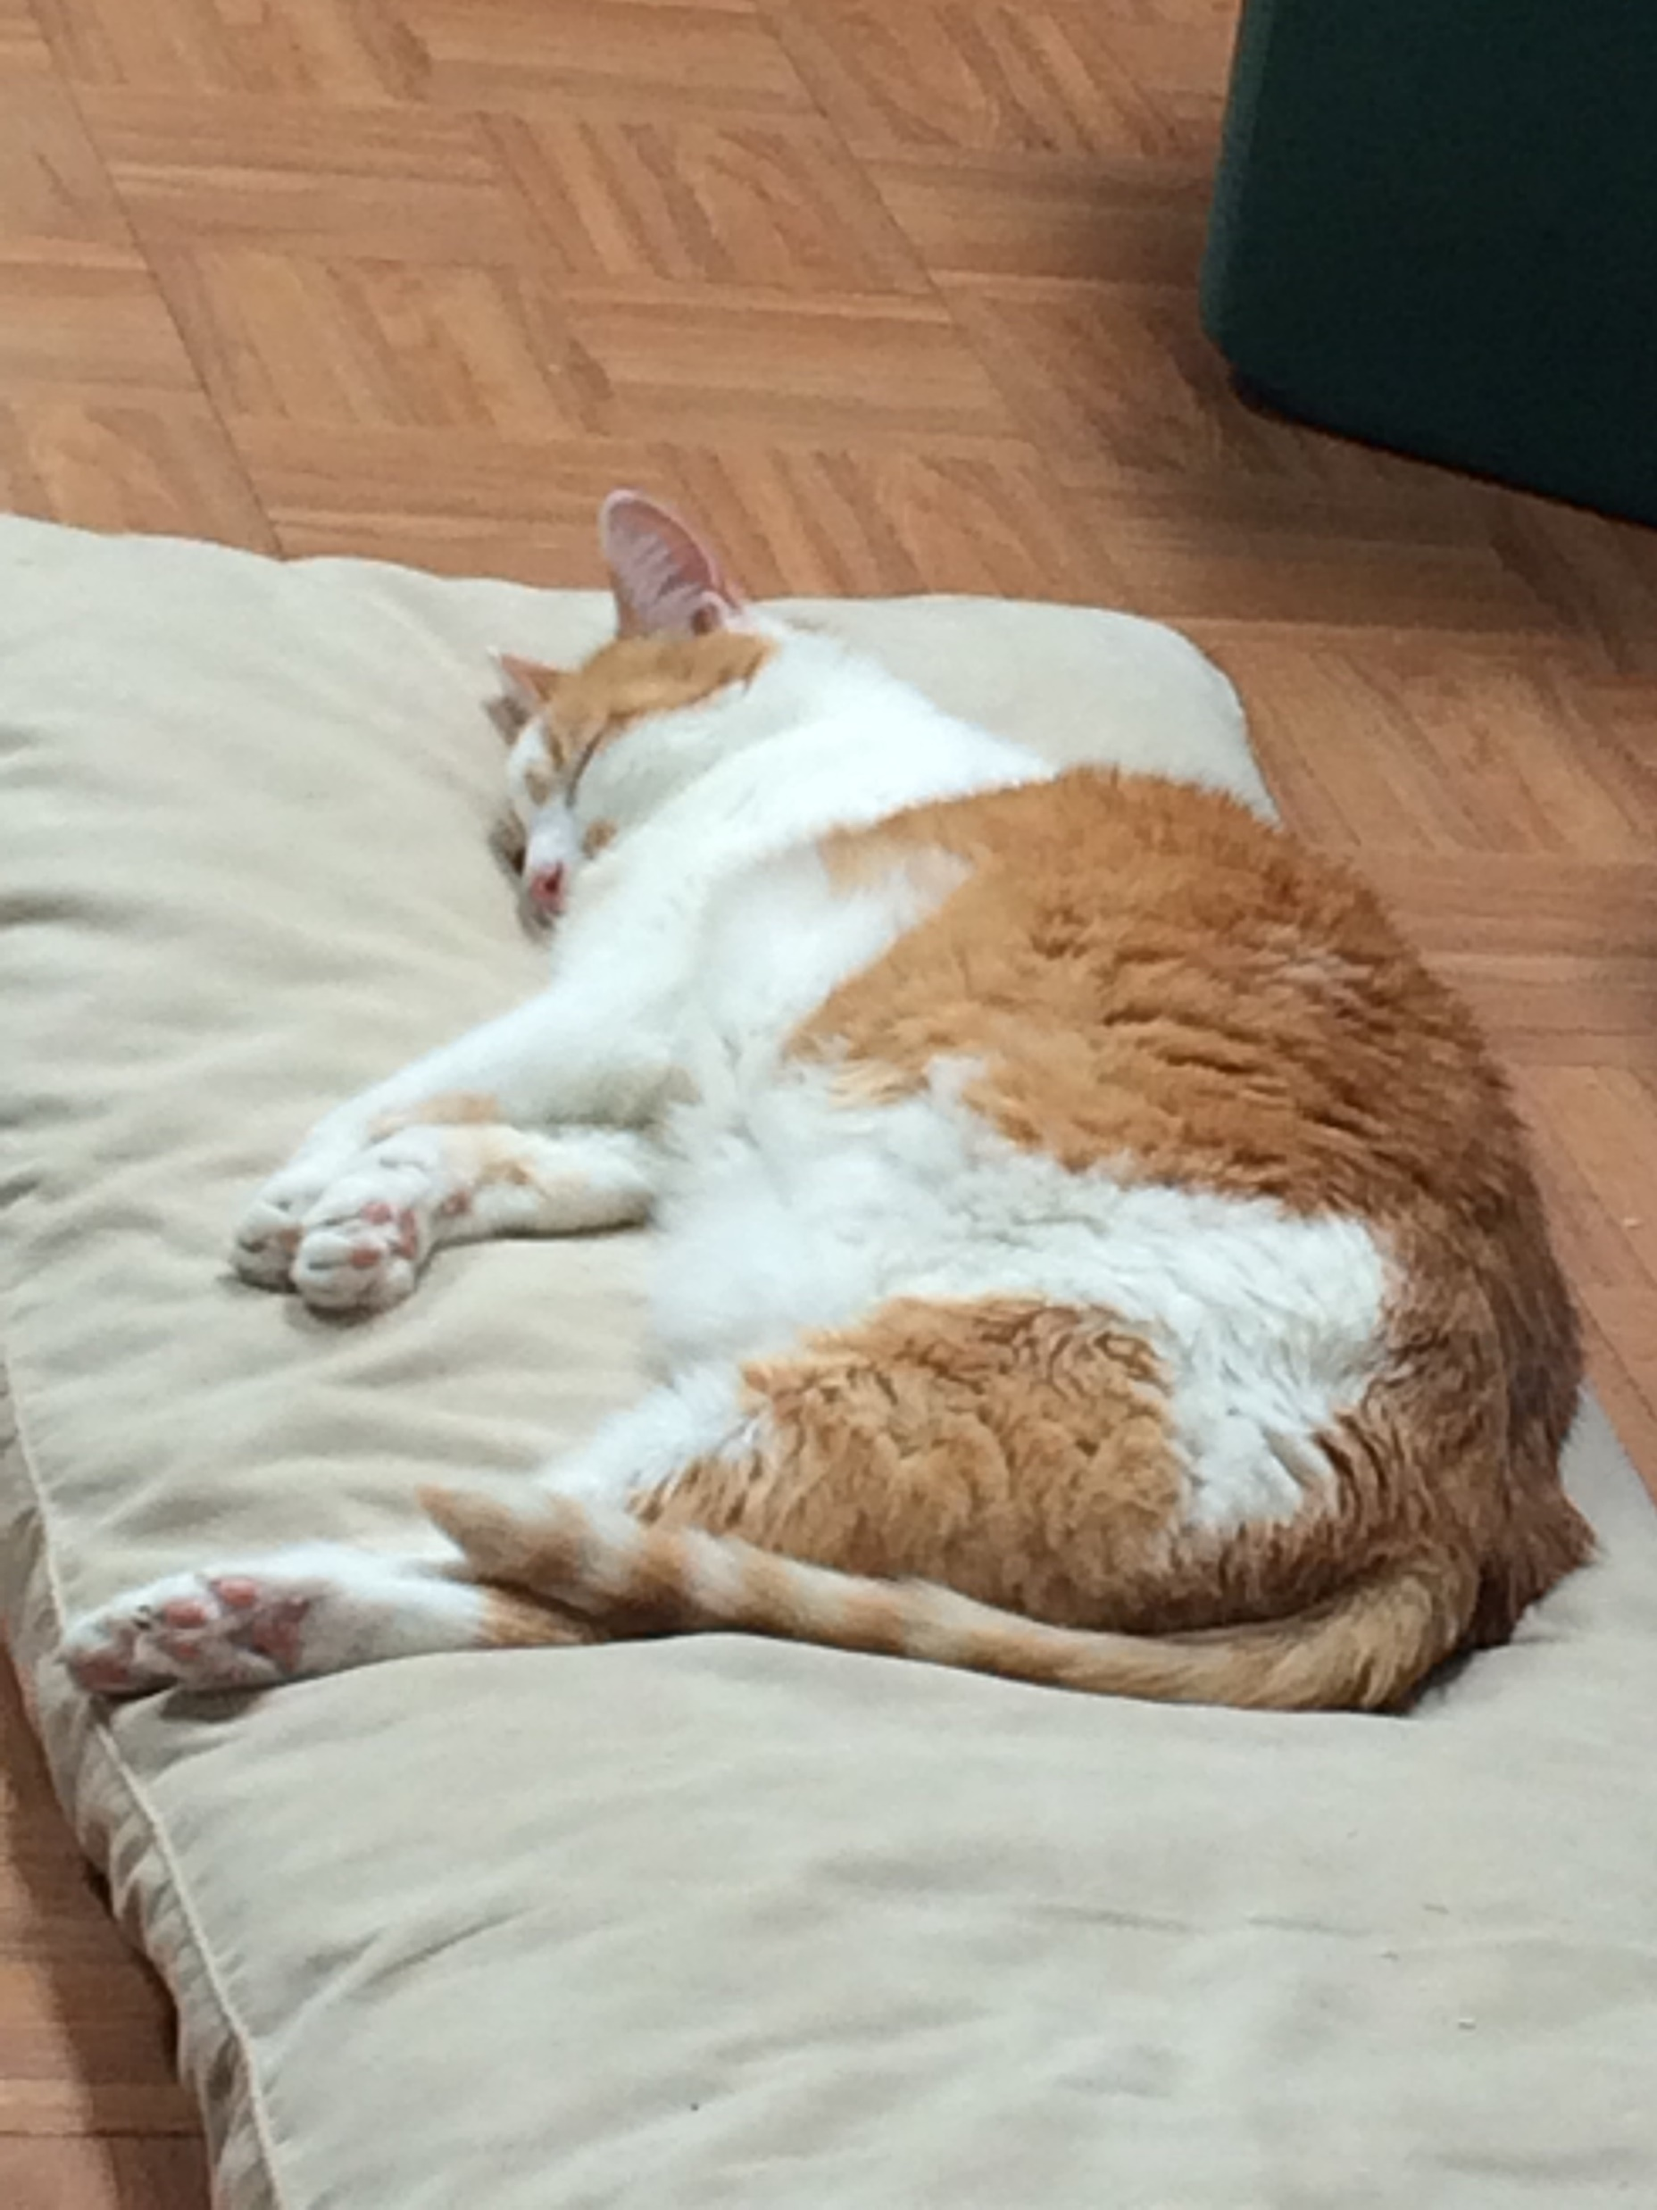
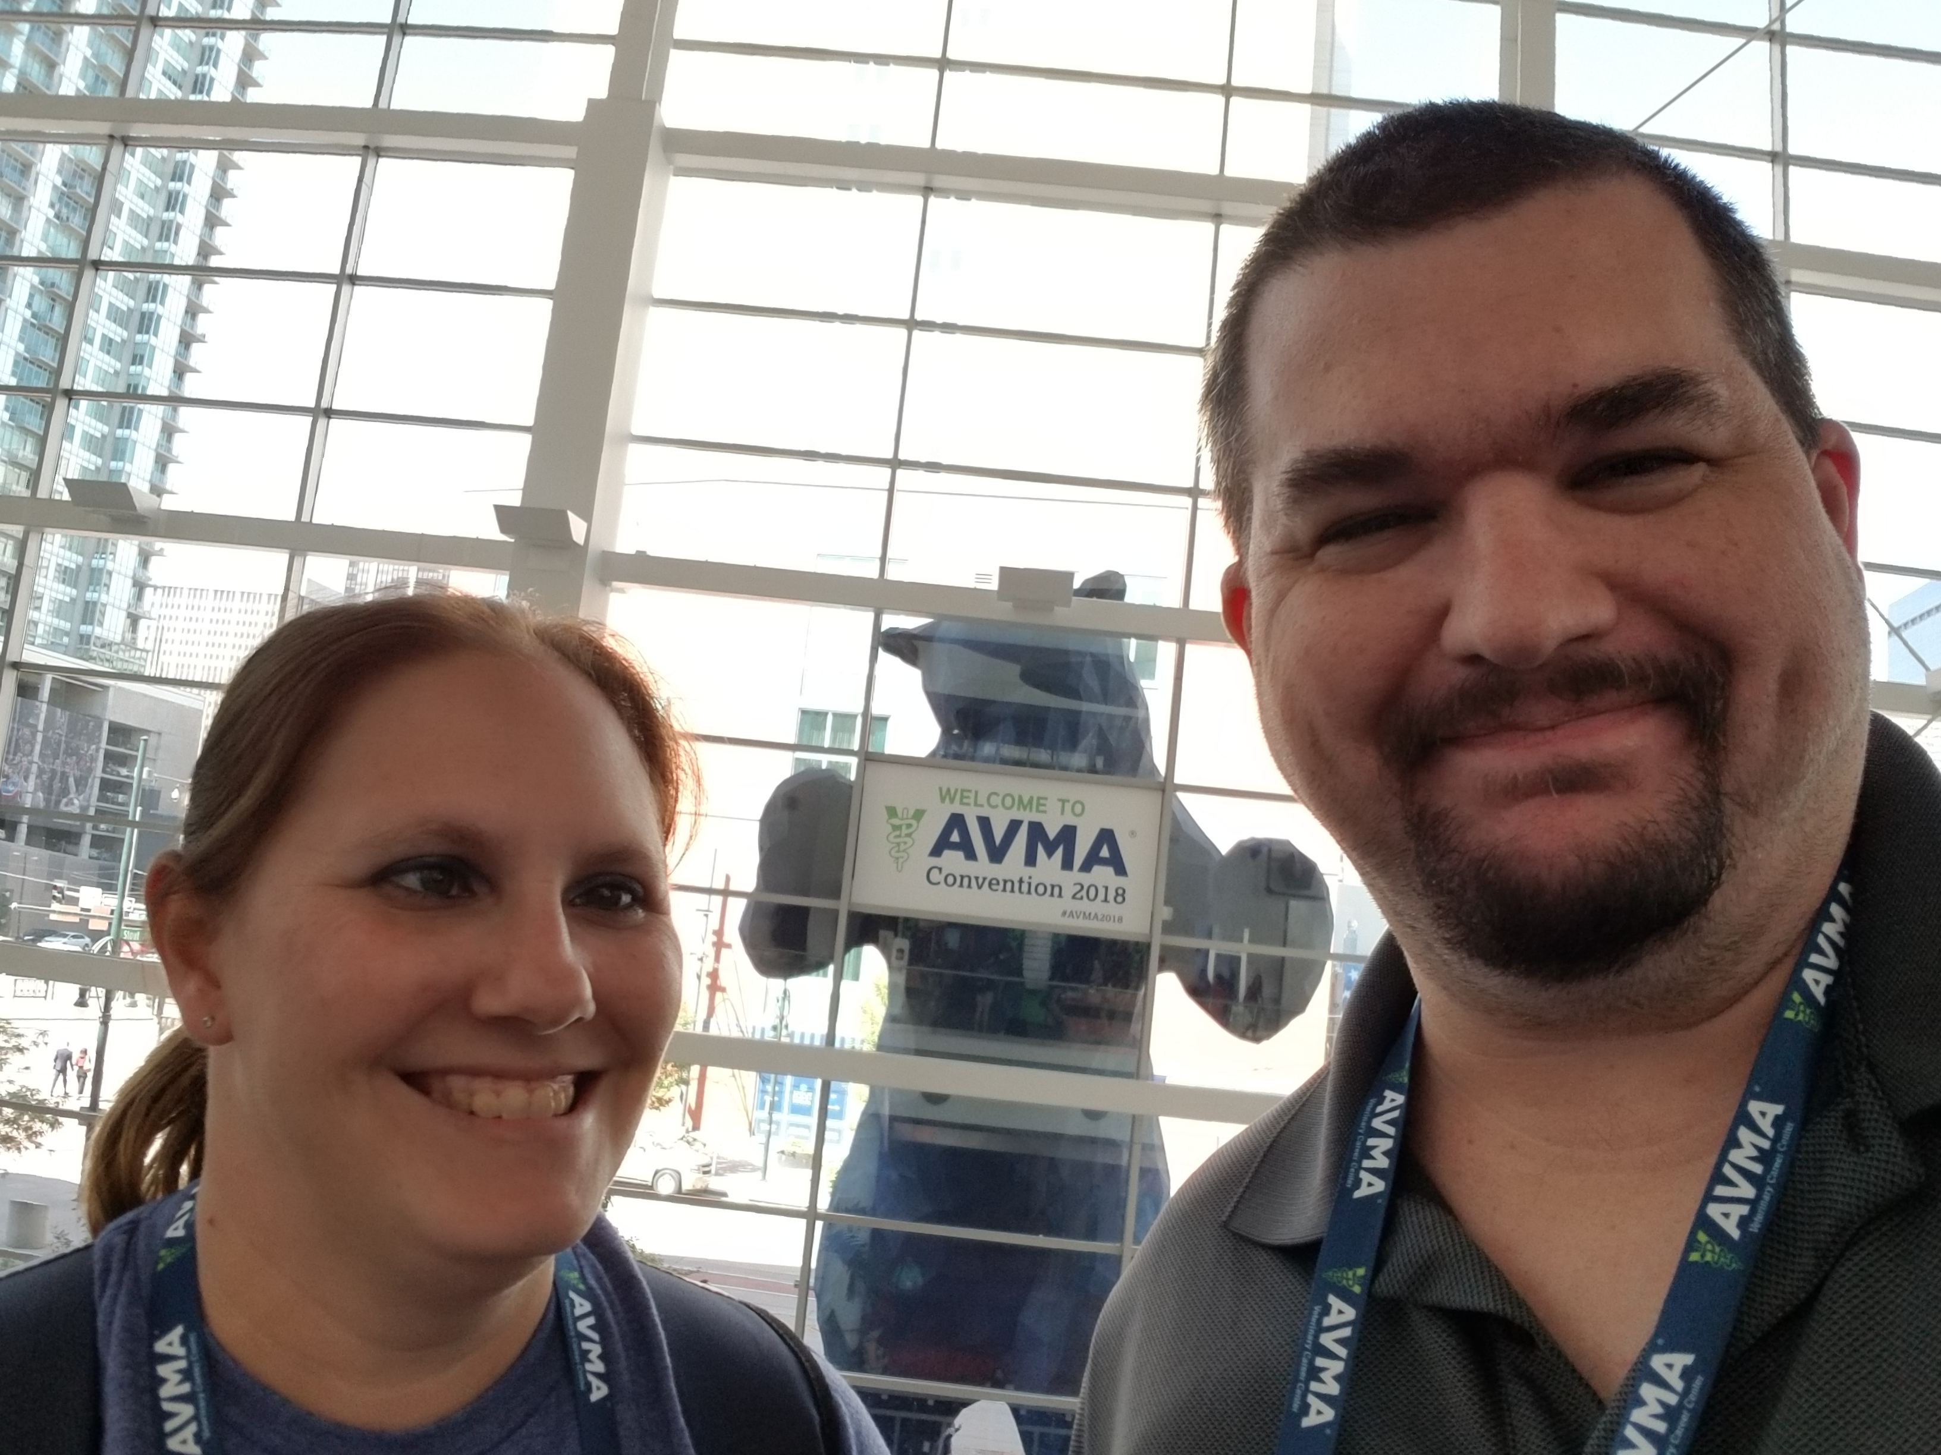
Robert John Smith
Elected May 6, 2017
Graduate of UT Dallas
Chief Technology Officer
Proud Father
Very Lucky Husband (according to April)

Slide 3
Section 255.003 of the Election Code provides as follows:
An officer or employee of a political subdivision may not spend or authorize the spending of public funds for political advertising.
This section does not apply to a communication that factually describes the purposes of a measure if the communication does not advocate passage or defeat of the measure.
A person who violates this section commits an offense. An offense under this section is a Class A misdemeanor.

Slide 4
Timeline
Dec 2017 Process Started
May 2018 Hired Consultant
Aug – Sep 2018 Public Input
Aug 30, 2018 D8 Bond Roundtable
Oct 25, 2018 D8 Town Hall
Sep – Dec 2018 Bond Study Committee
Jan – Feb 2019 3 Public Hearings, Deliberation
Feb 5, 2019 Election Called
May 4, 2019 Municipal Election Date

Slide 5
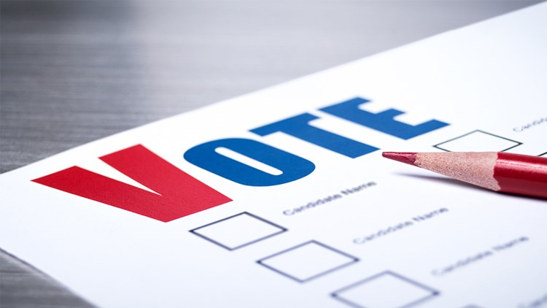
Ballot Items / “Buckets”

Slide 6
Ballot Propositions
A: Streets and Transportation $123m
B: Public Safety $ 51m
C: Storm Drainage $ 47m
D: Parks and Recreation $118m
E: Libraries $ 21m
F: Economic Development $ 46m
G: Municipal Facilities $ 6m
H: Animal Shelter $ 12m

Slide 7
Q1: Does Prop A pay for fixing my residential street? A1: Unlikely. Most street repairs are paid with cash instead of debt
Streets $123m
Bottleneck Improvements $14.0m
(Adding turn lanes, widening intersections)
Safety Improvements $ 3.5m
(Median Shaping, Moving Traffic Signals and Stop Bars)
Traffic Signals and Control Systems $ 7.5m
(Stop lights, Traffic Management Systems)
Emergency Services Overrides $ 2.5m
(Opticom devices on top of the stoplight bars)
Catalyst Areas $14.6m
(Downtown, IH-30, Medical District)
Railroad Crossings $ 2.1m
New Alleys $ 3.5m
Sidewalks $ 9.0m

Slide 8
Complete Rebuilds / Expansions
Naaman School Rd (Orange) $32.6 m
Holford Rd (Green) $22.4 m
Lyons Rd (Purple) $10.9 m
Shiloh Rd - Kingsley to Miller (Red) $ 3.0 m*
Leon Rd (Pink) $ 2.3 m
* The RTC has contributed significantly to Shiloh Rd

Slide 9
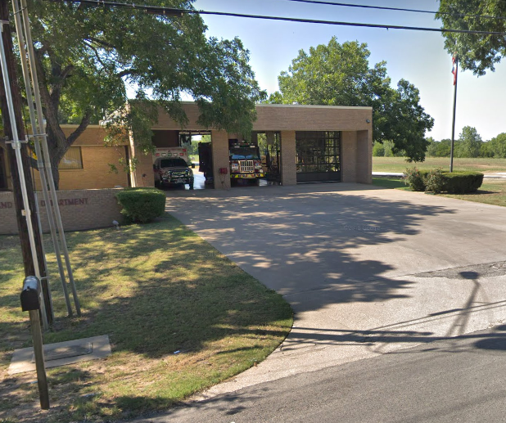
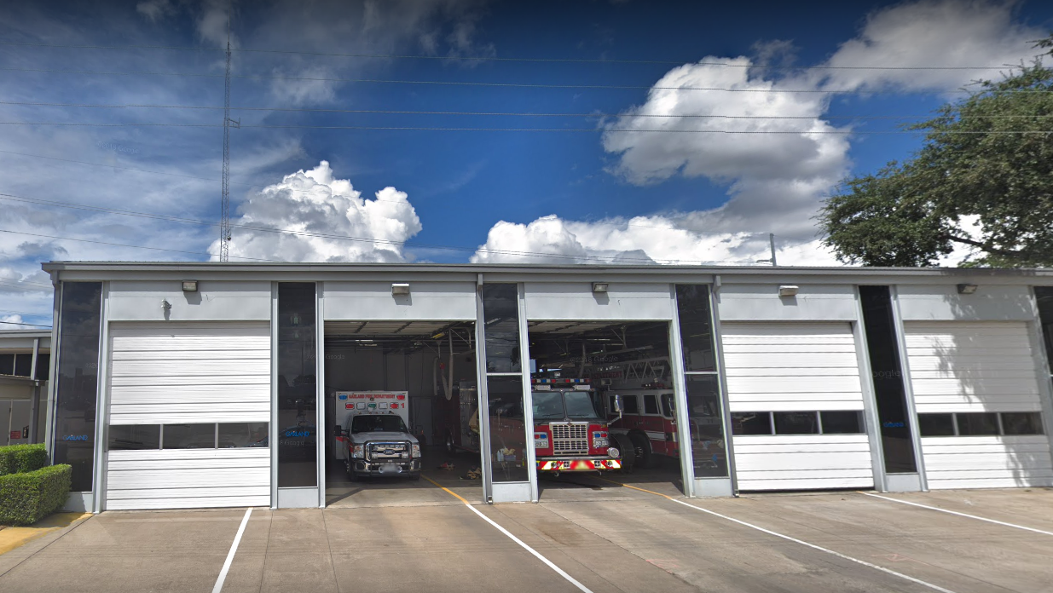
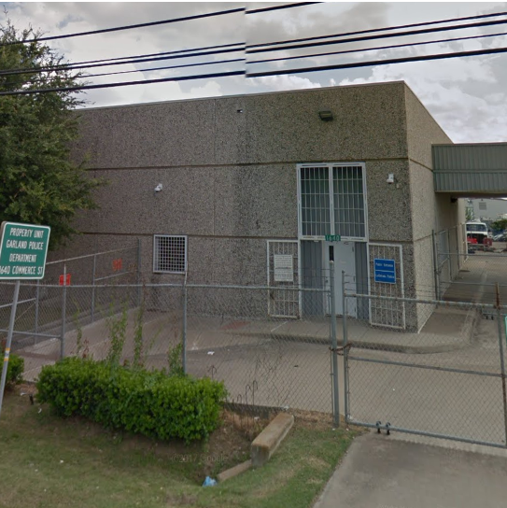
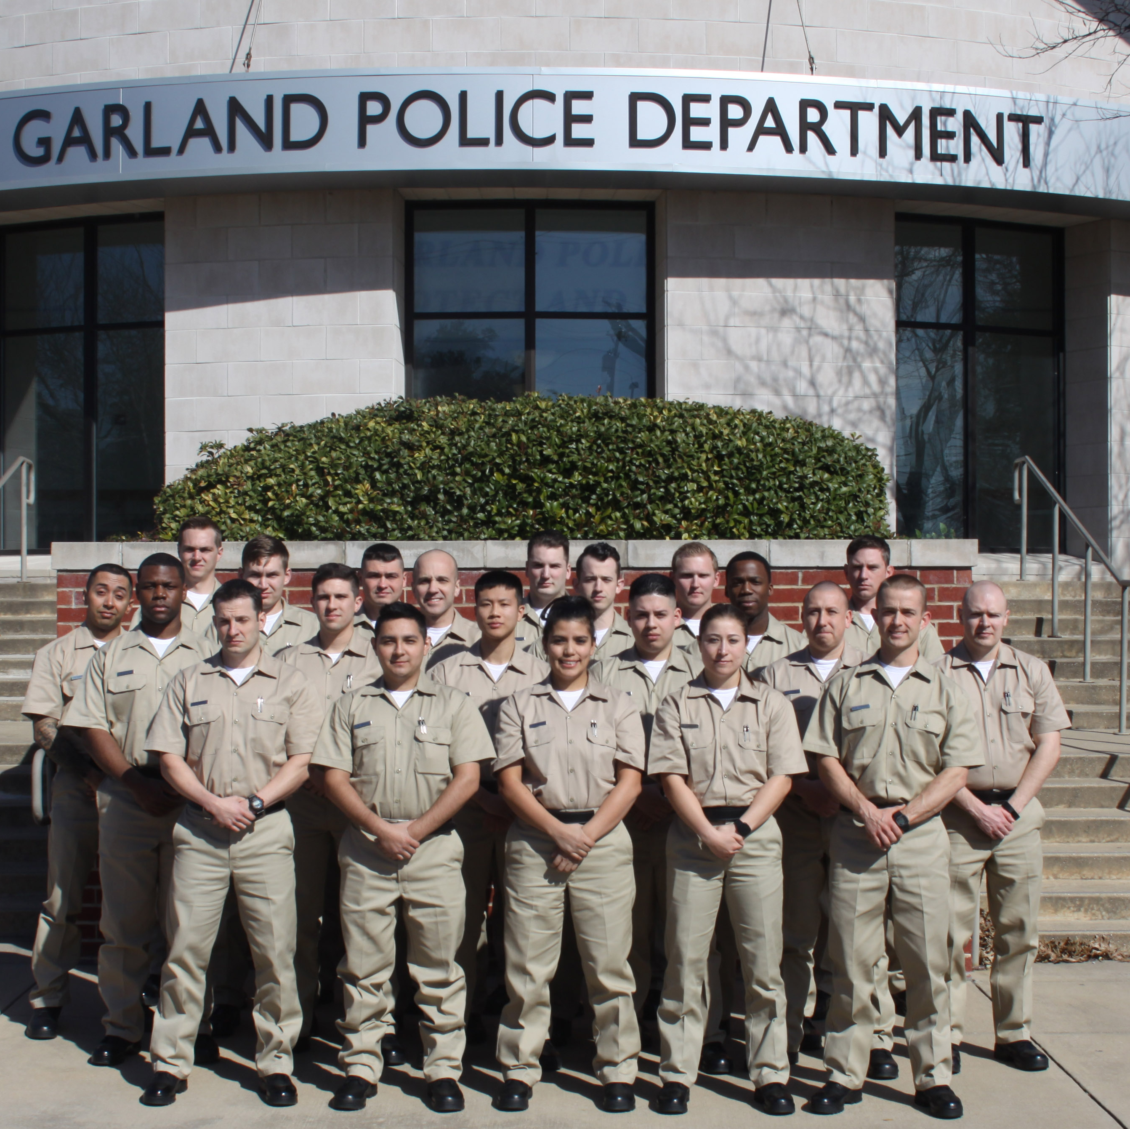
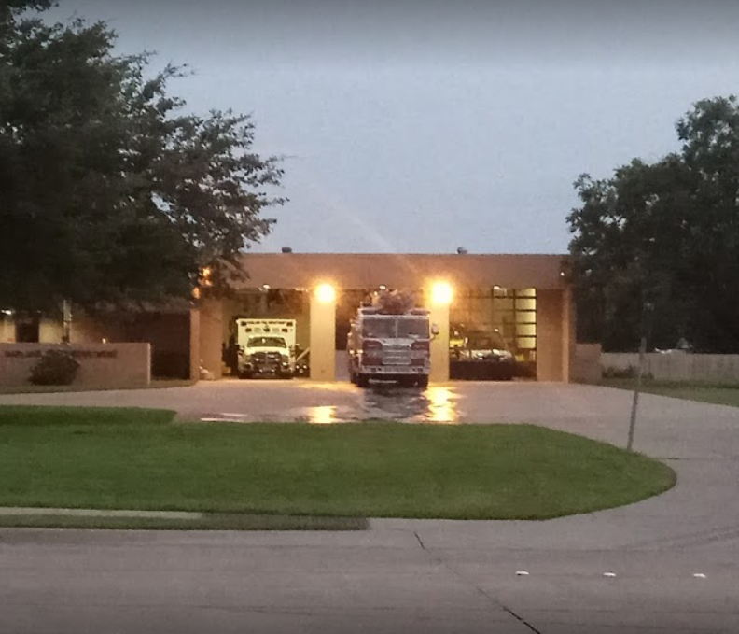
Public Safety $51.35m
Fire
Stations 1, 6, 7 $28m
Police
Evidence Room $18m
Shooting Range $ 3m
Station Security $ 2m

Slide 10
Storm Drainage $47.35m
PROGRAMS
Drainage + Streets $700k
Drainage 50/50 Program $1.8m
Local Flooding Program $2.5m
Flood-Prone Properties $4.0m

Slide 11
Storm Drainage Target Areas
Garvon West (Red) $10m
Country Club Park (Purple) $3.5m
Lakewood Addition (Orange) $3.5m
Western Heights No 4 (Green) $1.0m
Montclair No 2, No 3 (Blue) $4.2m
Saturn Springs Estates (Pink) $10m

Slide 12
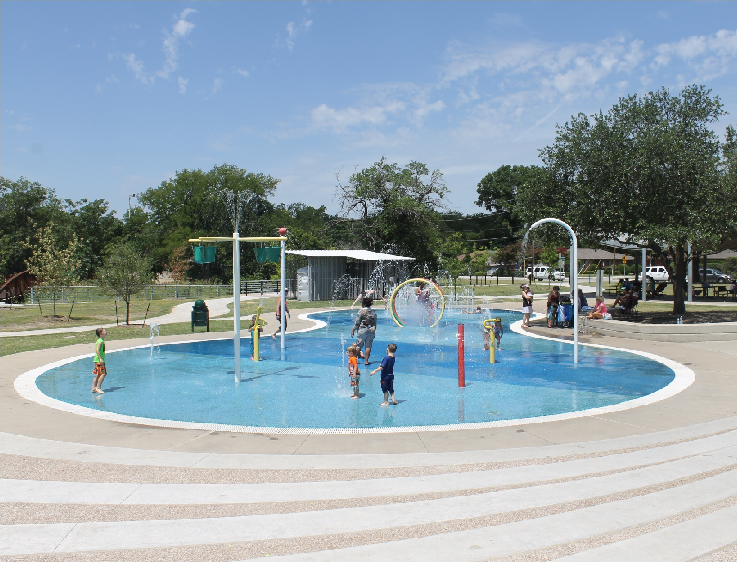
Parks $117.75m

Slide 13
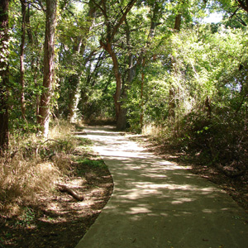
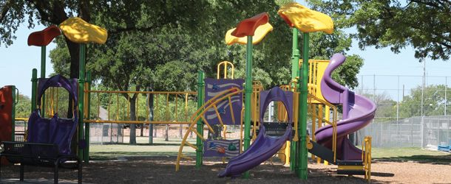
Programs $31.5m
Sports Field Renovations (1m/yr)
Parking and Park Roads (1.5m/yr)
Playground Replacement (1m/yr)
Trail Development (1m/yr)*
* Dallas county usually cost-shares

Slide 14
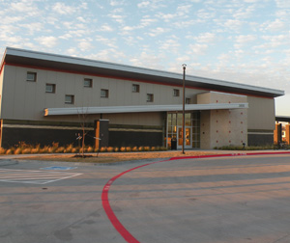
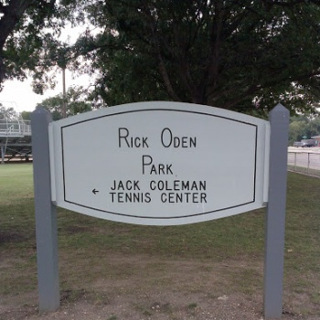
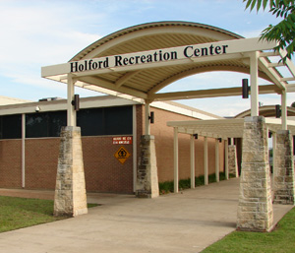
Projects $86.25m
Lighting at Winters Park $2 m*
City-wide Aquatics $20 m
Catalyst Area Improvements $15 m
Holford Rec Center Rebuild $24 m
Audubon Rec Center Minor Reno $3.3 m
Hollabaugh Rec Center Completion $8.0 m
Garland Senior Activity Center $4.0 m
Rick Oden Park Overhaul $10 m
* GP&L would contribute roughly $1.5m as well

Slide 15
Libraries $21m
Walnut Creek Branch Library $10.9m
Upgrades to North/South/Central $10.1m

Slide 16
Economic Development $46m
Land Acquisition and Parcel Assemblage Program
$14m
Neighborhood Vitality Program –
$7m
Revitalization of Retail, Commercial, and Shopping Centers / Redevelopment of Commercial Corridors, Retail Centers, Multi-family, and Industrial Areas
$25m

Slide 17
Municipal Buildings $6m
Streets HQ and Sign Shop Remodel
Reconfiguration of Space
Asbestos Abatement

Slide 18
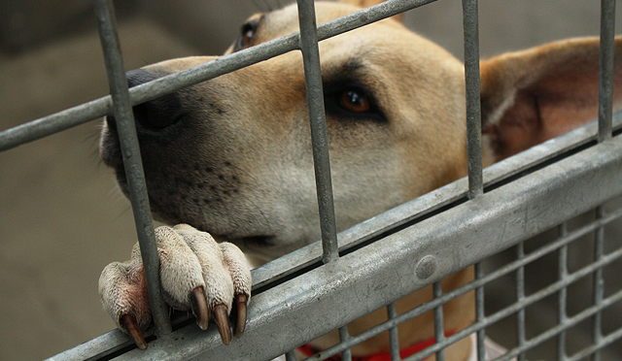
Animal Shelter $12m
Current Facility:
Built in 1965
Indoor / Outdoor Design
Sewage Issues
New Facility:
Would combine adoption center / shelter ops
On Hwy 66
Priced to be built in Year 1

Slide 19
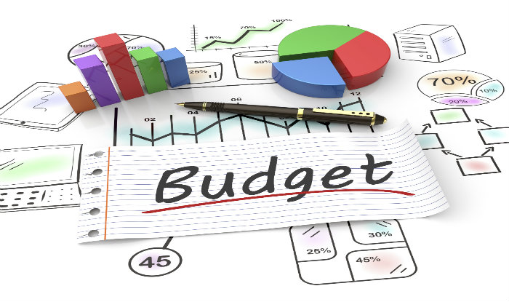
Tax Rate Impact

Slide 20
Bond Items

Slide 21
Math (Sorry)
Current Tax Rate: 70.46 cents / $100
(39.40 O&M, 31.06 Debt Service)
Programs and Projects:
$384,235,065
Inflation / Escalation / Contingency:
$39,443,106
Total:
$423,678,171
10 yr
Implementation:
+8.5 cents/$100
7 yr
IMPLEMENTATION:
+9.5 CENTS/$100

Slide 22
OBLIGATORY SPREADSHEET 1

Slide 23
OBLIGATORY SPREADSHEET 2

Slide 24
Taxes

Slide 25
2019 Municipal Election
ELECTION DAY, SATURDAY MAY 4th

Slide 26
Email: council8@garlandtx.gov
Mobile: 469.223.4723
Website: robertjsmithtx.com
Bond Tax Calculator: http://www.robertjsmithtx.com/bond/

